Slide 1



Slide 2

A set is an unordered collection of items. Every element is unique and must be immutable.
However, the set itself is mutable. We can add or remove items from it.
Sets can be used to perform mathematical set operations like union, intersection, symmetric difference etc.

Slide 3

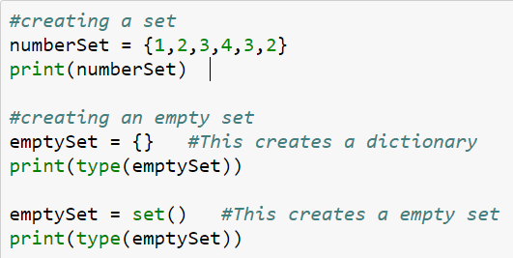
A set is created by placing all the elements inside curly braces {}, separated by comma or by using the built-in function set().
The elements can be of different types (integer, float, tuple, string etc.).
But a set cannot have a mutable element, like list, set or dictionary, as its element.

Slide 4
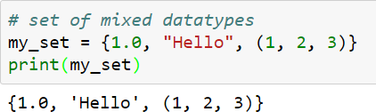
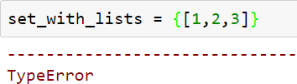
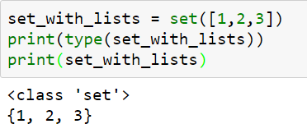
A set can contain elements of different type
A set cannot contain lists.
We can convert a list to set using set function

Slide 5
LIST
SET
append
extend
Insert
add
Update
○ -----------
Pop
remove
○ ------------
remove
discard

Slide 6

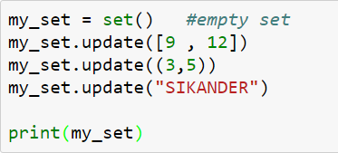

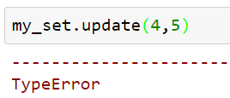
Sets are mutable. But since they are unordered, indexing have no meaning.
We cannot access or change an element of set using indexing or slicing.
We can add single element using the add() method and multiple elements using the update() method.
The update() method can take tuples, lists, strings or other sets as its argument.
In all cases, duplicates are avoided.

Slide 7

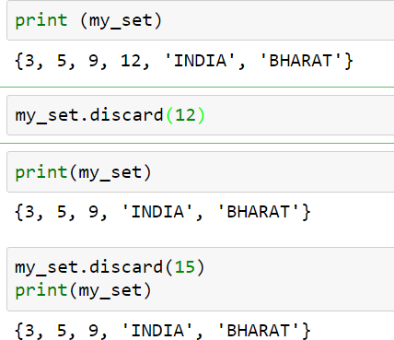
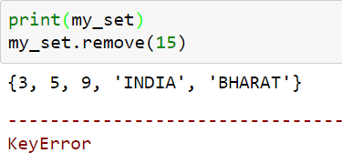
A particular item can be removed from set using methods, discard() and remove().
using discard() if the item does not exist in the set, it remains
unchanged.
But remove() will raise an error in such condition.

Slide 8

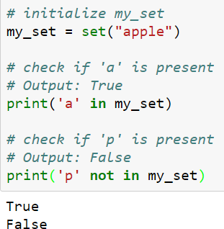
○ We can test if an item exists in a set or not, using the in operator.

Slide 9
1. Given an list of elements, remove the duplicate elements? 2. Read a string and find the number of unique characters in it.
Exercise 1. DIY

Slide 10
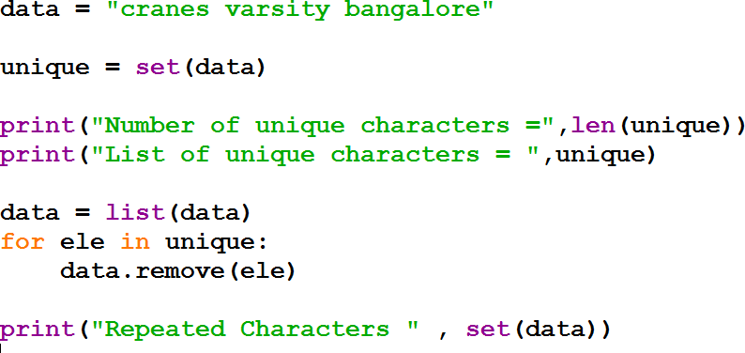
2. Read a string and find the number of unique characters in it.

Slide 11
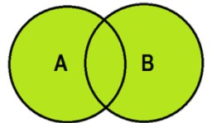
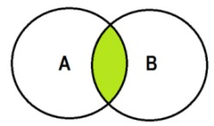
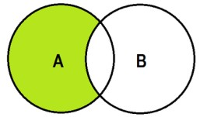
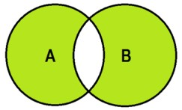
Sets can be used to carry out mathematical set operations like union, intersection, difference and symmetric difference.
We can do this with operators or methods.
Method | Operator
union | |
intersection | &
difference | -
symmetric_difference | ^

Slide 12
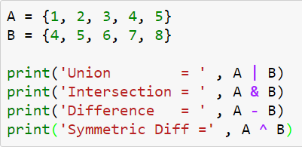


Slide 13

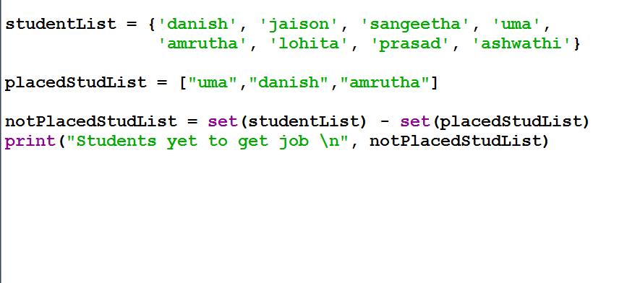

Slide 14

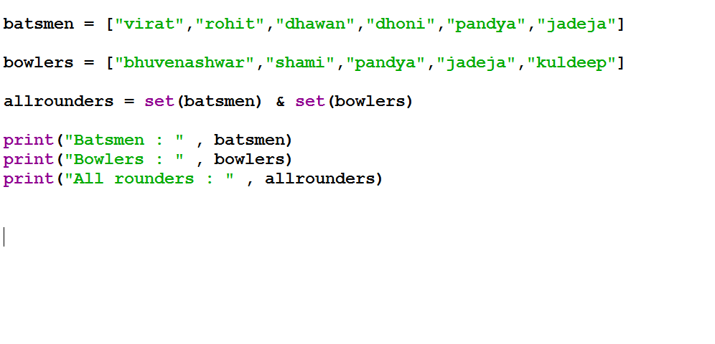

Slide 15
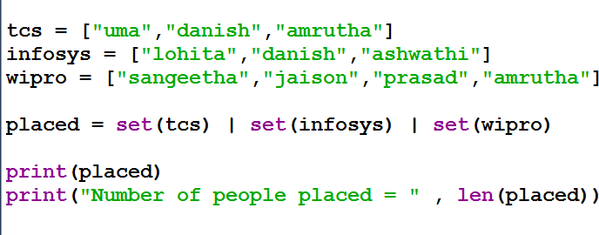

Slide 16

We have seen the applications of union, intersection,
difference and symmetric difference operations, but these operations do not make any changes or mutations to the set.
We can use the following operations to create mutations to a set:
Method | Operator
update | |= | Update the set by adding elements from an iterable/another set.
intersection_update | &= | Update the set by keeping only the elements found in it and an iterable/another set.
Difference_update | -= | Update the set by removing elements found in an iterable/another set.
symmetric_difference_update | ^= | Update the set by only keeping the elements found in either set, but not in both.

Slide 17
Isdisjoint– This method will return True if two set have a null intersection
Issubset – This method reports whether another set contains this set
Issuperset – This method will report whether this set contains another set

Slide 18
